Slide 2
The process for 18+, ongoing volunteers
Clearance Step 1) Complete the online screening form and Safe Environment training through the Diocese of Dallas
Clearance Step 2) Create a VolunteerHub profile: ccdallas.volunteerhub.com
Clearance Step 3) Complete a phone interview with a CCD employee of the site you’re interested volunteering in

Slide 3
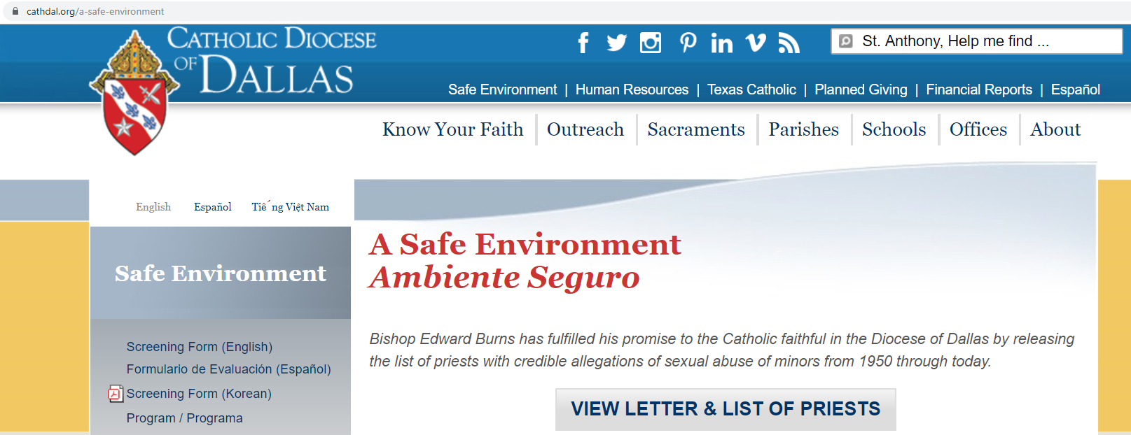
Clearance Step 1: Go to the Safe Environment page on the Catholic Diocese of Dallas website & click “Screening Form” on the left.
Direct link: cathal.org/a-safe-environment

Slide 4
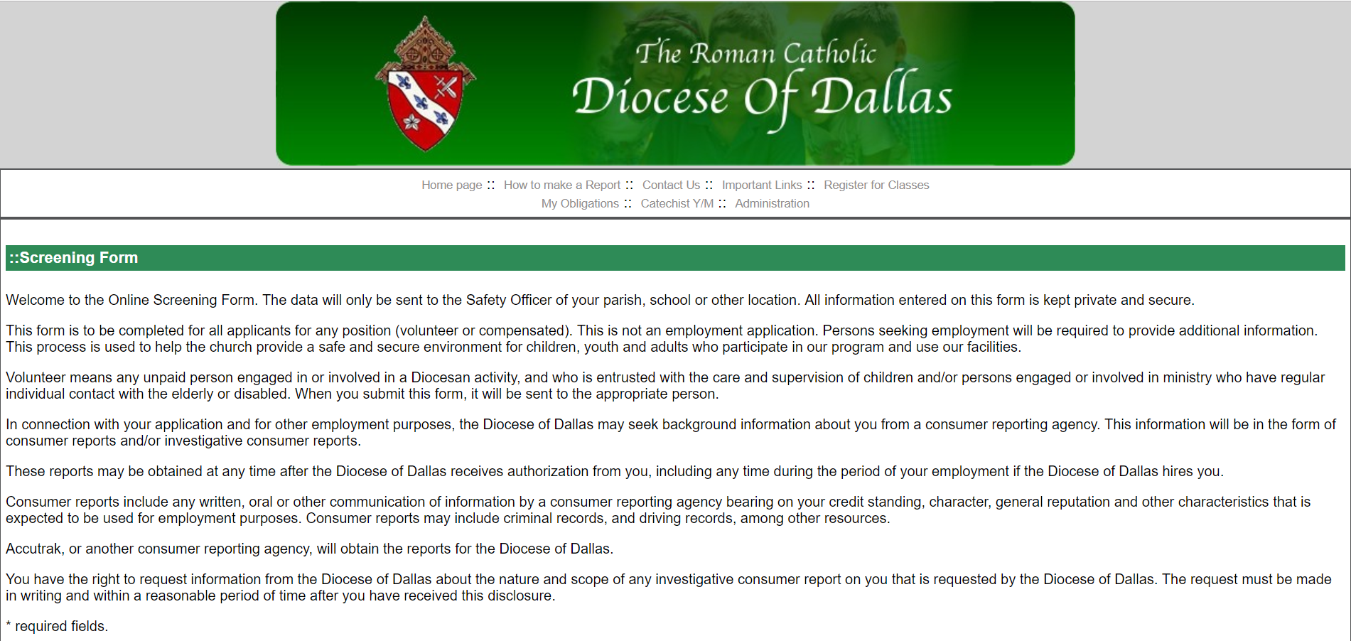
This is what you will see. Scroll down to begin filling out the form.

Slide 5
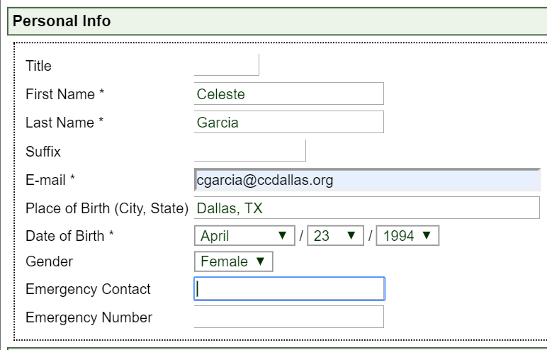
Section 1: Fill out your personal info.
A unique email address distinct from anyone else in the system is required in order to complete this form.

Slide 6
Section 2: Provide your address information.
Section 3: Provide a phone number. At least one is required.

Slide 7
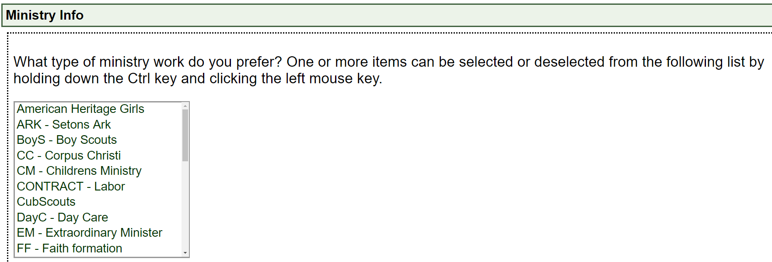
Section 4: Ministry info will be left blank
Section 5: Location – Catholic Charities-Dallas;
Position – Volunteer;
Title – leave blank

Slide 8
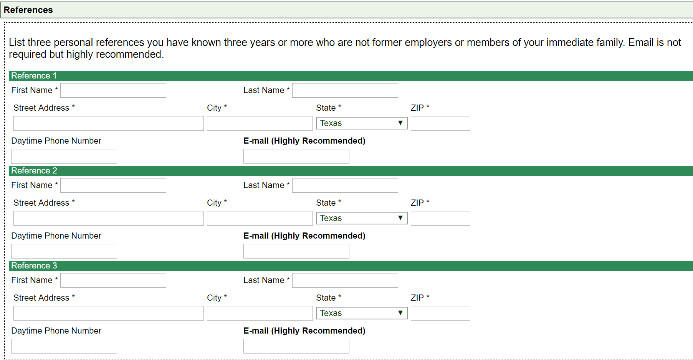
Section 6: Provide the information for your 3 references. For CCD, the reference e-mail is required.

Slide 9
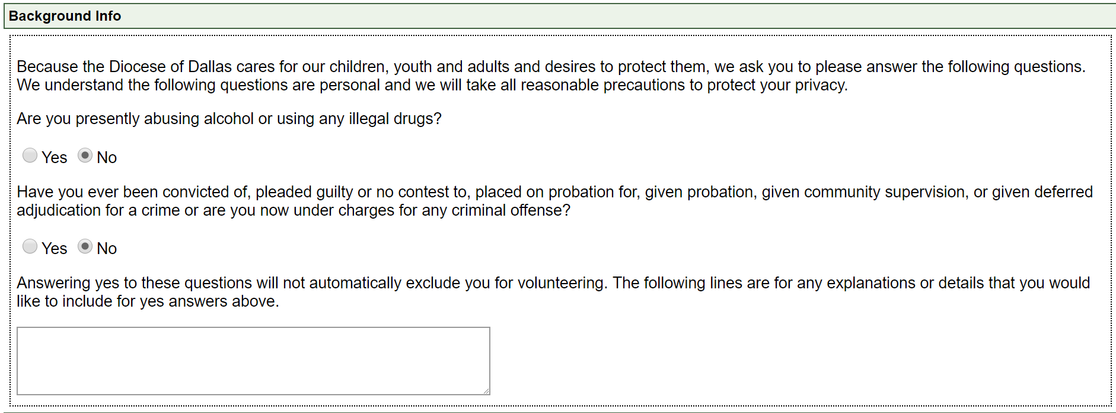
Section 7: Answer the following questions regarding your background info and provide any additional information in the space provided.

Slide 10
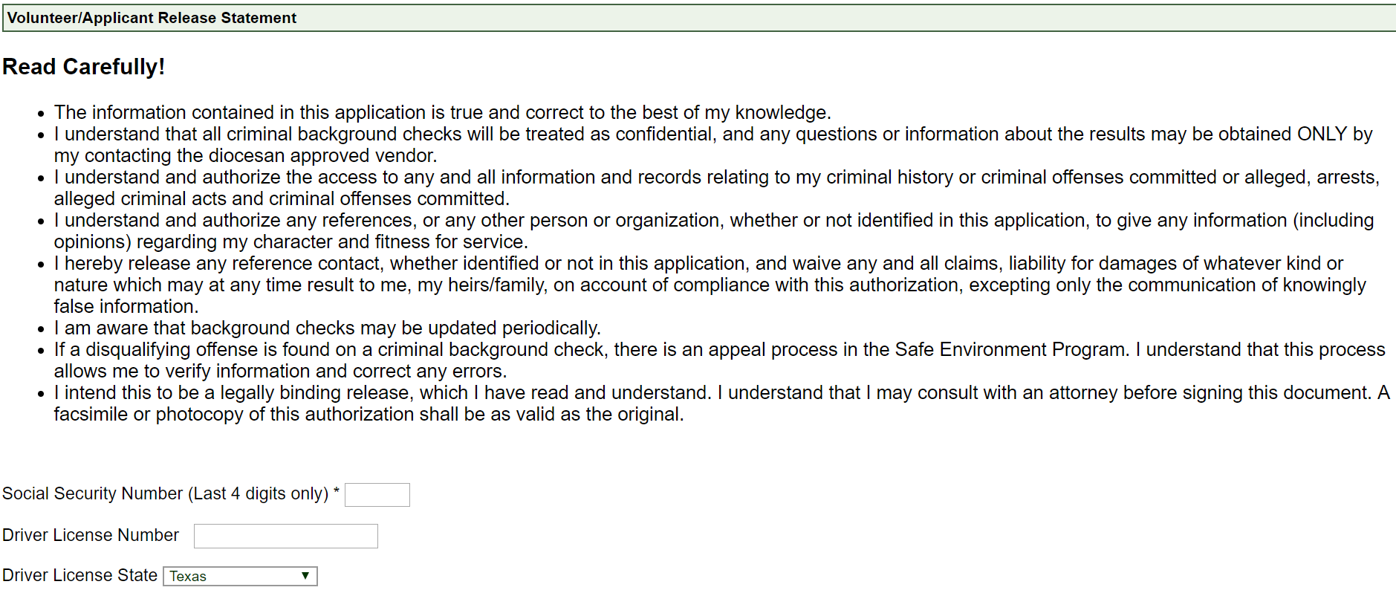
Section 8: Initiate your background check. You can provide your Driver’s License # OR SSN.
If you have an extenuating circumstance and you have neither to provide, please contact volunteer@ccdallas.org or 469-801-8170 to proceed.

Slide 11
Section 9: Read the Policy Acknowledgment and Social Media Policy Acknowledgement & check off the boxes
Section 10: Submit the clearance form

Slide 12
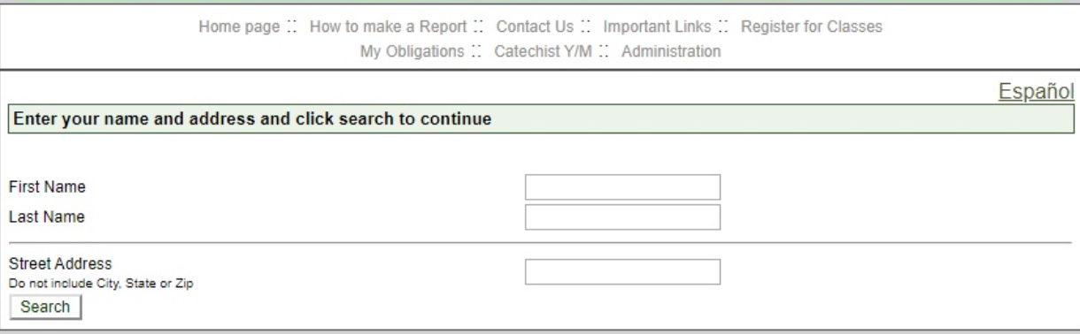
Complete the Safe Environment training once your screening form has been submitted. Click on “My Obligations” at the top of the page A login page will show up. Type in your information then click “search”

Slide 13
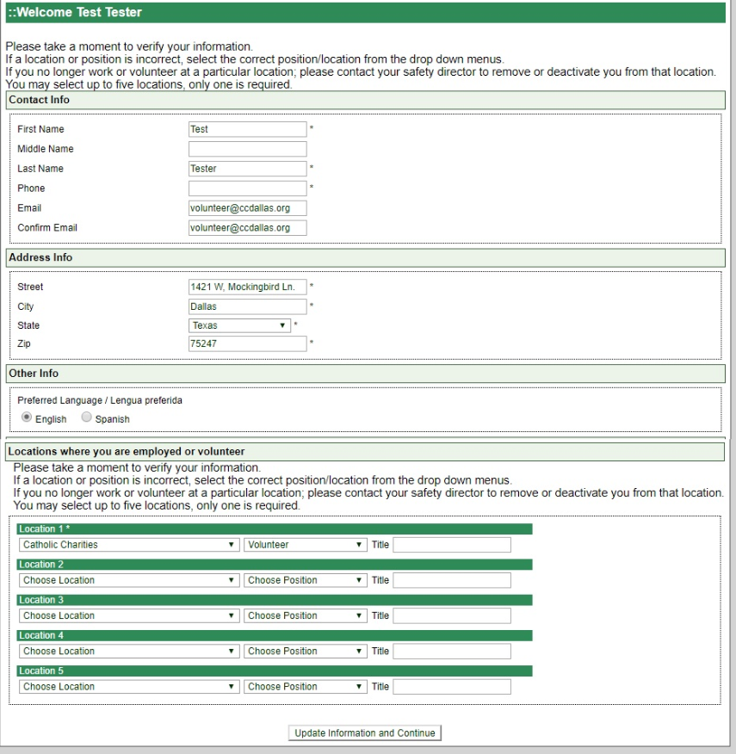
This is the next screen you will see. Verify your information and make sure “Catholic Charities” is listed as the location and “Volunteer” is the position.
Once your information has been verified, click “Update Information and Continue”

Slide 14
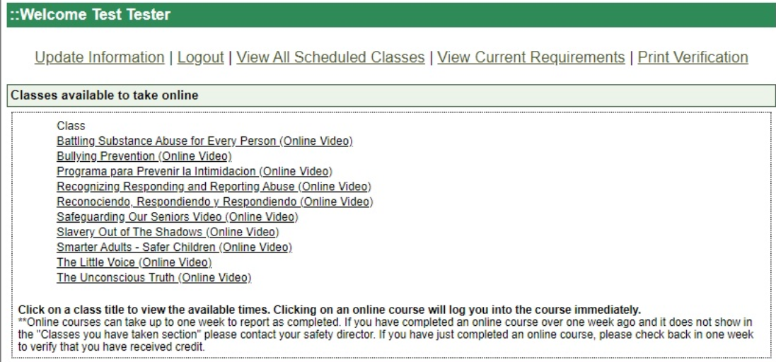
You can choose to watch any of the training videos from the list provided.

Slide 15
You will see this screen before beginning the Safe Environment video training.
Please make note of the requirements to receive credit for completing the program.

Slide 16
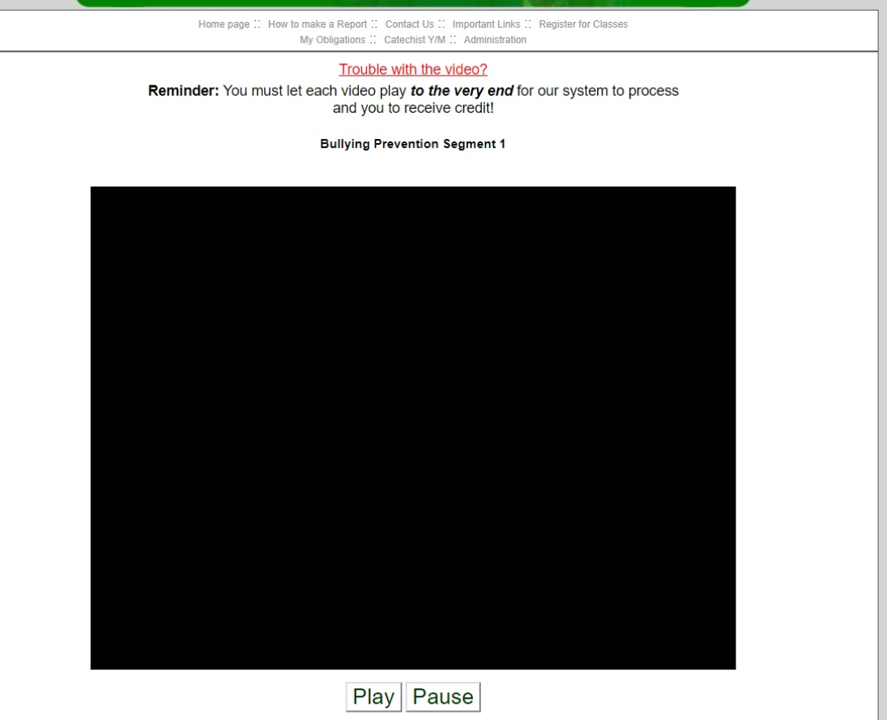
Begin the video and answer the questions that follow each segment.
This is the final step for the screening process.

Slide 17
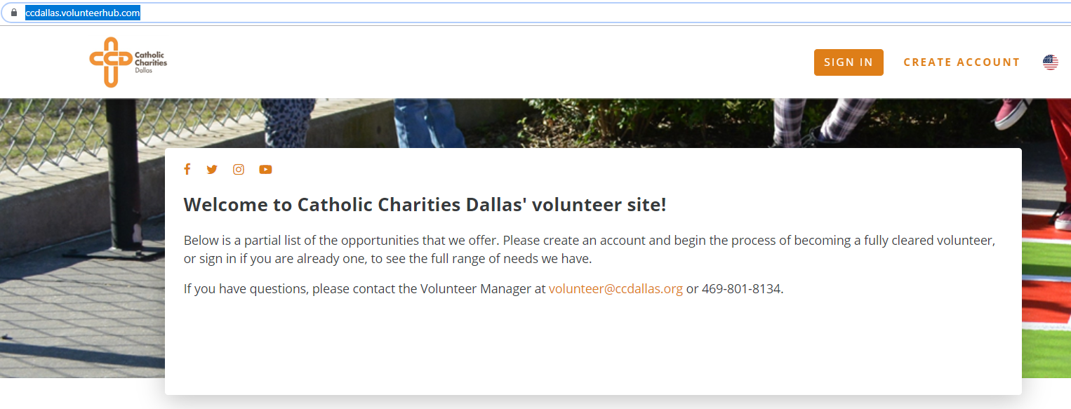
Clearance Step 2: Create your VolunteerHub profile. This is where you will let us know your volunteer area of interest, your skills, and your availability.
Direct link: https://ccdallas.volunteerhub.com/

Slide 18
Clearance Step 3: Phone Interview
Once your screening form and Safe Environment video training have been completed, and your VolunteerHub profile created, you will be put into a list to be phone interviewed by a CCD employee of the site you’re interested volunteering in.
This interview is the final step in the clearance process. You will be able to view the full range of volunteer opportunities through your VolunteerHub profile once your clearance form, Safe Environment training, and interview have been reviewed and approved by the CCD Volunteer Office.

Slide 19
If you have any questions or require any assistance, please contact
Celeste Garcia, Volunteer Coordinator, at volunteer@ccdallas.org or 469-801-8170

